Slide 1
CouchBase Database overview
Lorenzo Frangella - 1899674
Large Scale Data Management - Big Data Management
Sapienza University of Rome

Slide 2
Table of contents
Introduction
Tool installation and setup
Dataset import
Query tool
Analytics tool
References

Slide 3
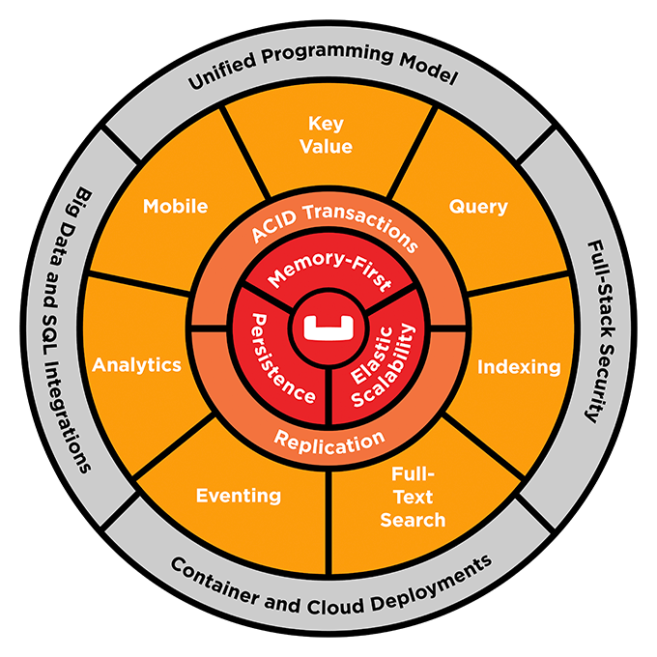
CouchBase
CouchBase is a non-relational database, is document-based. Data in couchbase is stored as JSON documents
Modularity of components make CouchBase suitable for any kind of application
Is also developed to be easy to scale
CouchBase – Lorenzo Frangella 1899674

Slide 4
CouchBase – Lorenzo Frangella 1899674

Slide 5
CouchBase Architecture
Cluster Manager is not removable it handles the distribution of CouchBase nodes
Data Service Supports the storing, setting, and retrieving of data-items by key
Index Service Creates indexes, for use by the Query and Analytics
Query Service Parses queries specified in the N1QL query-language, executes the queries, and returns results
Search Service Create indexes specially purposed for Full Text Search
Analytics Service Supports join, set, aggregation, and grouping operations performed in real time
CouchBase – Lorenzo Frangella 1899674

Slide 6
CouchBase Architecture
Eventing Service Supports near real-time handling of changes to data
Backup Service Supports the scheduling of full and incremental data backups, either for specific individual buckets, or for all buckets on the cluster.
CouchBase – Lorenzo Frangella 1899674

Slide 7
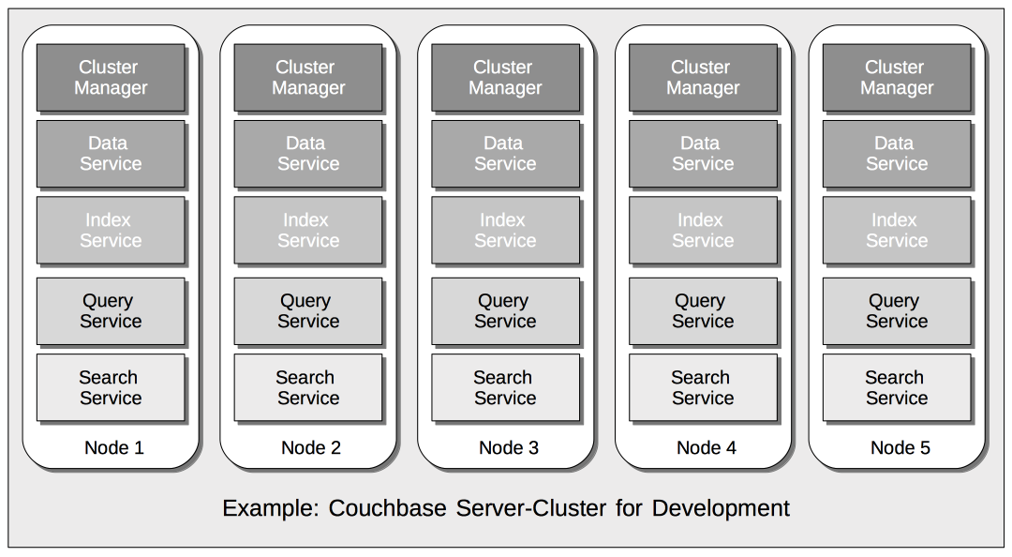
CouchBase – Lorenzo Frangella 1899674

Slide 8
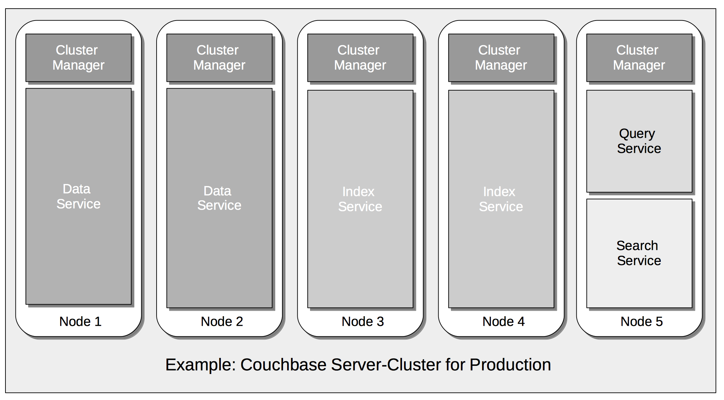
CouchBase – Lorenzo Frangella 1899674

Slide 9



Storage Architecture
Cluster
Server
CouchBase – Lorenzo Frangella 1899674

Slide 10
Storage Architecture
Cluster
Buckets
CouchBase – Lorenzo Frangella 1899674

Slide 11
Storage Architecture
Cluster
Scopes
CouchBase – Lorenzo Frangella 1899674

Slide 12

Storage Architecture
Cluster
Scopes
CouchBase – Lorenzo Frangella 1899674

Slide 13
Storage Architecture
Cluster
Collections
CouchBase – Lorenzo Frangella 1899674

Slide 14

Storage Architecture
Cluster
Collections
CouchBase – Lorenzo Frangella 1899674

Slide 15
Storage Architecture
Cluster
Documents
CouchBase – Lorenzo Frangella 1899674

Slide 16
Benefits of this structure
The architecture of CouchBase allows developers to fine tune the system based on type of data that a bucket is going to store.
Buckets configuration include:
Replica decision
Time to leave
Transaction resolution policy
CouchBase – Lorenzo Frangella 1899674
CouchBase – Lorenzo Frangella 1899674

Slide 17

Query Language SQL++ (N1QL)
SQL++, also called N1QL is the query language of CouchBase. Its sintax is similar to SQL, this choice was made from CouchBase’s developers to make easier for a company to migrate to CouchBase platform without learning another language from scratch.
The main difference resides in the data models that they handle.
SQL++
SQL

Slide 18

Data Replication and Sharding
Number of replicas can be decided during setup
Sharding is performed using an hash function
on id of the document (CRC32)

Slide 19
Data Replication and Sharding
Number of replicas can be decided during setup
Sharding is performed using an hash function
on id of the document (CRC32)

Slide 20


CouchBase installation
+

Slide 21





Deployed Scenario
data
query
index
data
backup
analytics
eventing
search

Slide 22
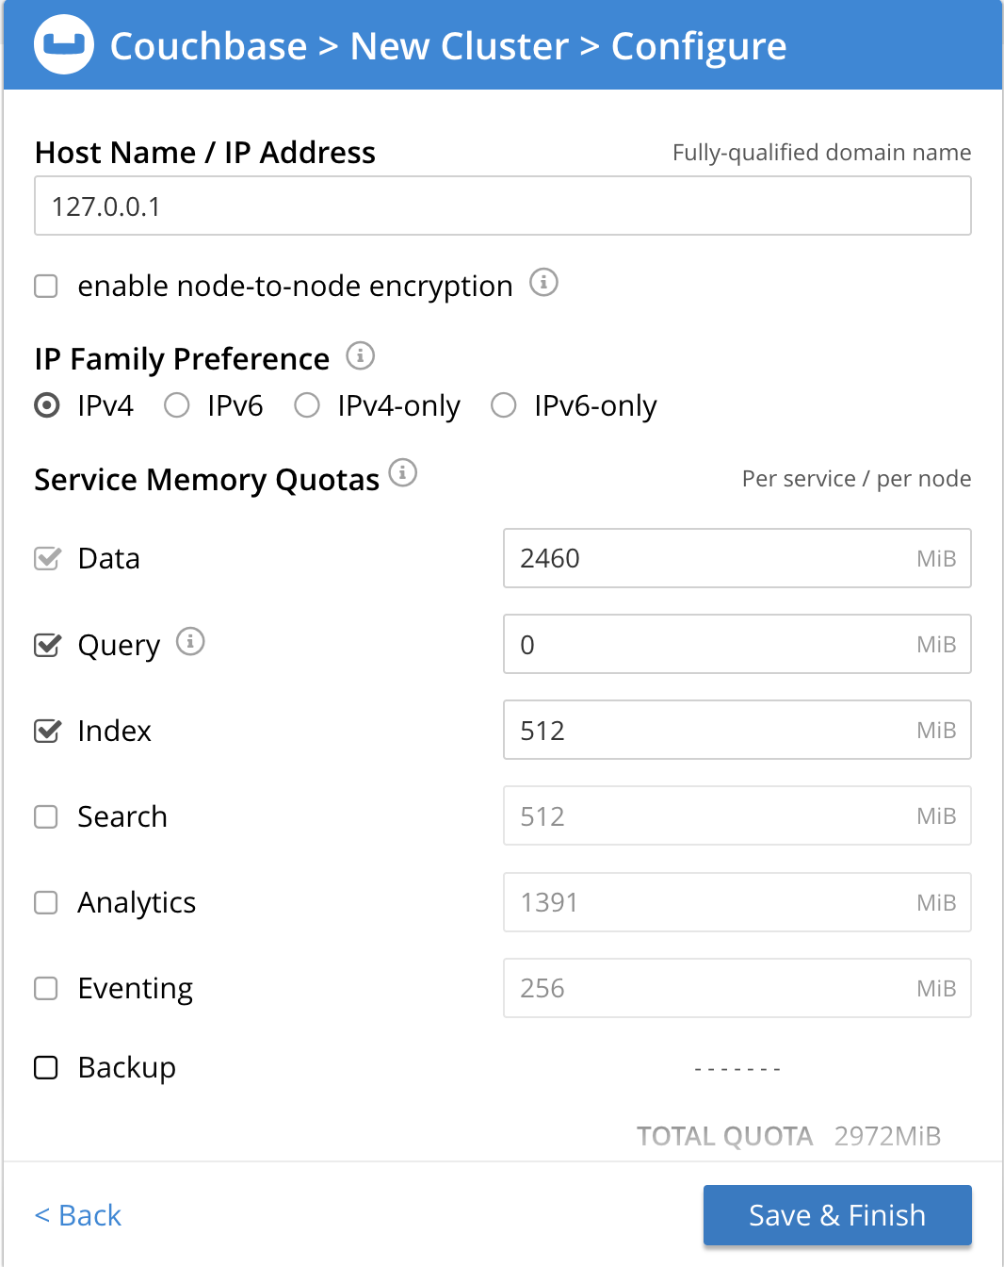
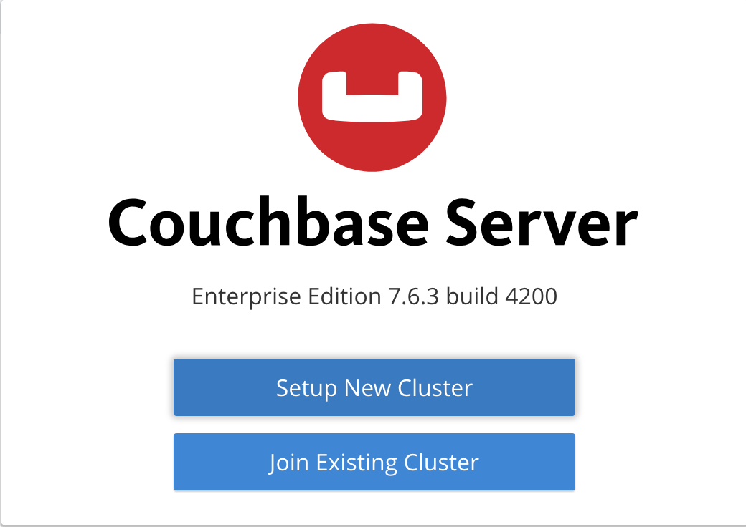

Slide 23
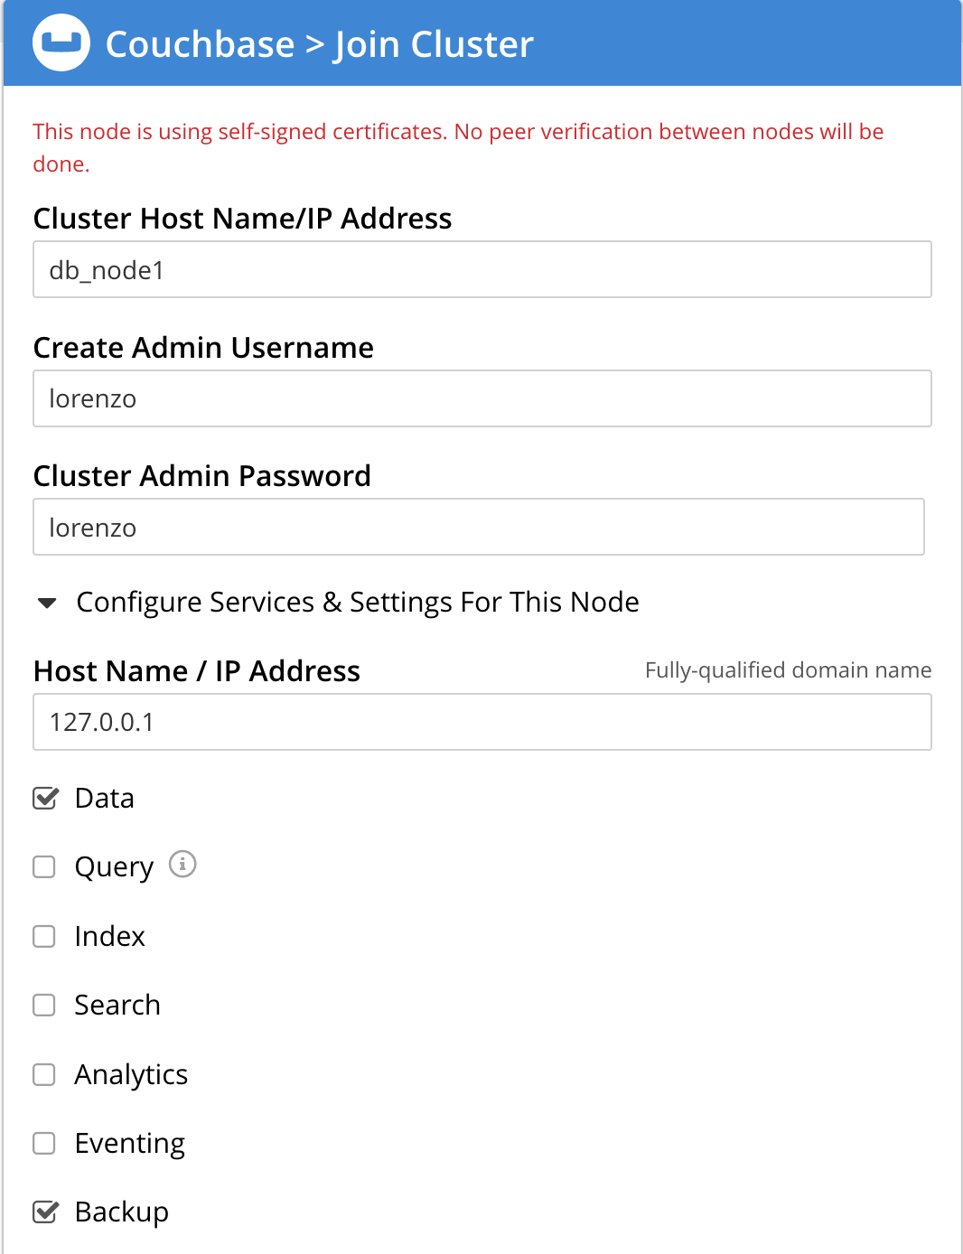

Slide 24
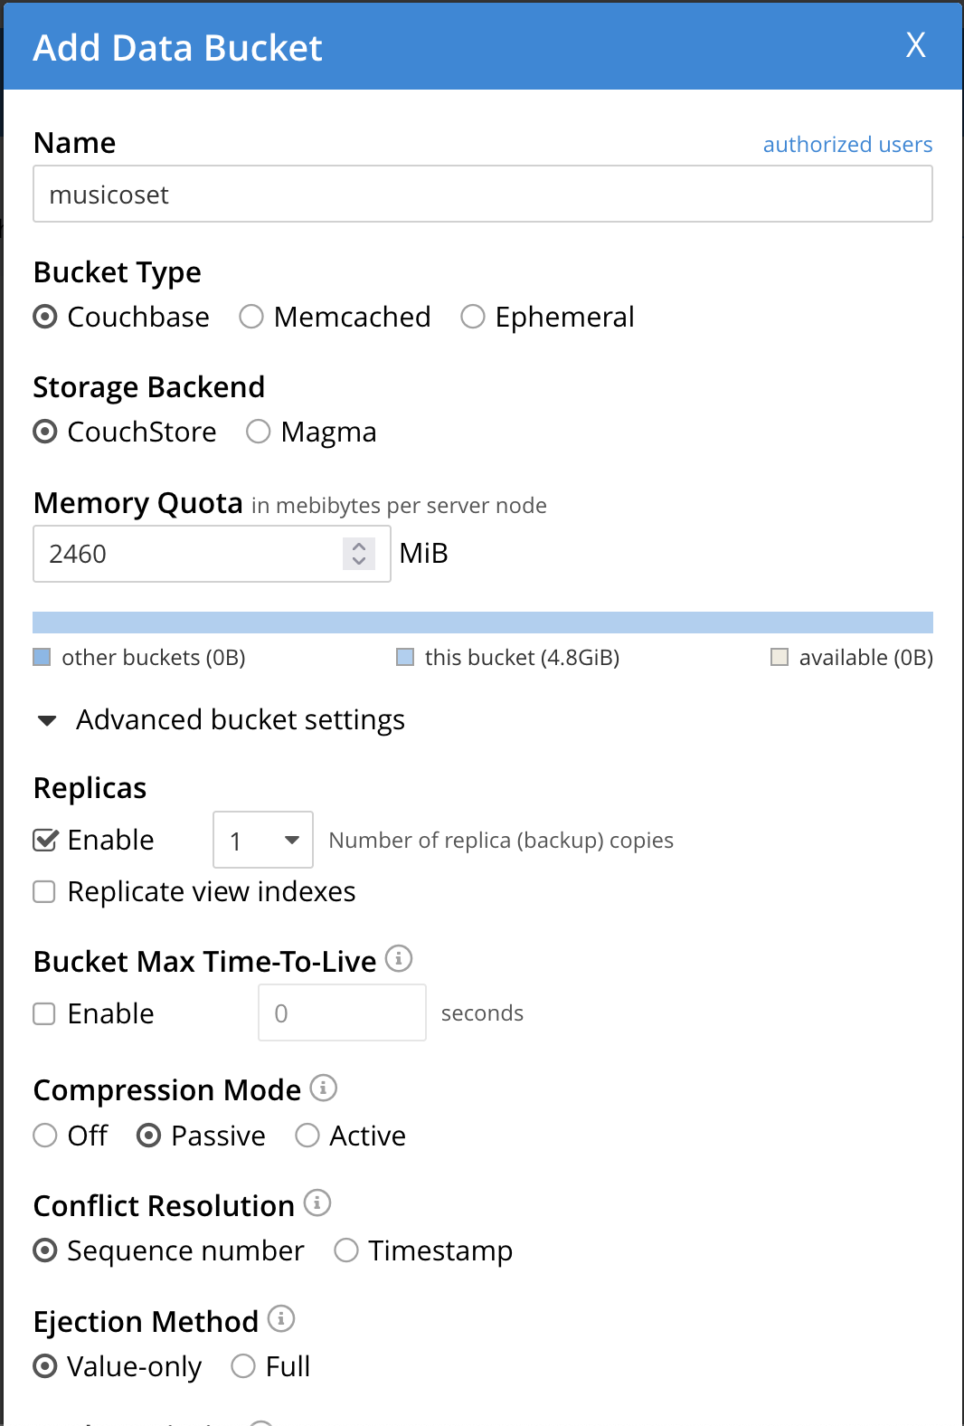
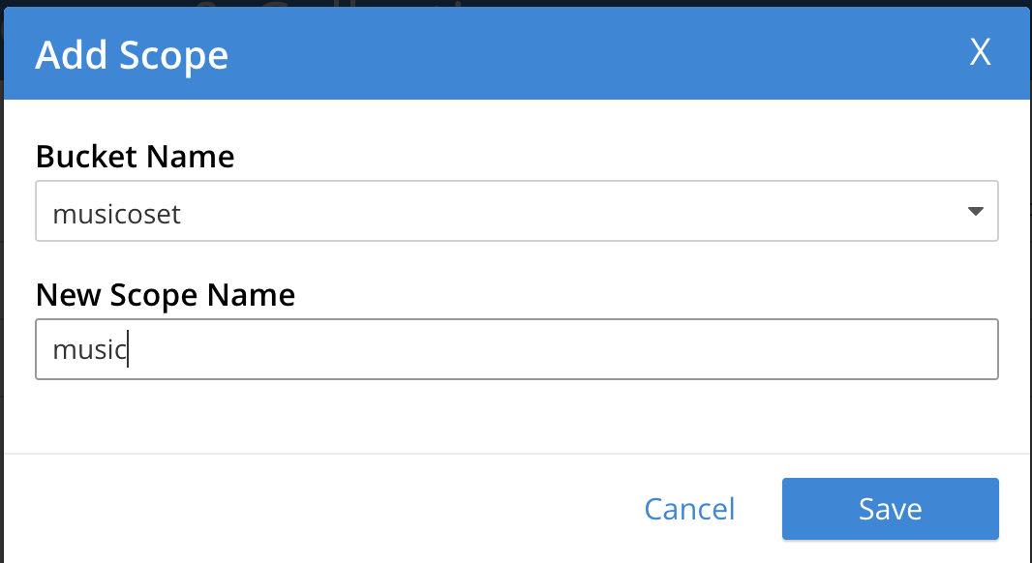
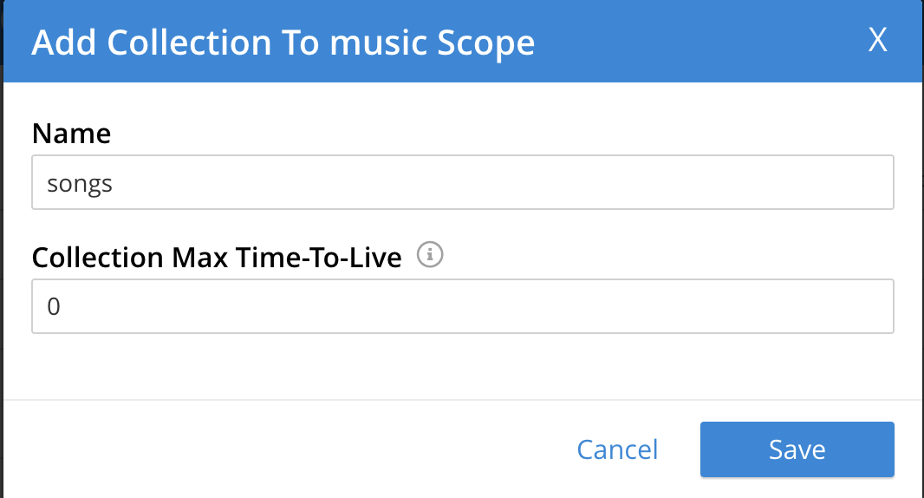

Slide 25
Data Import and Ingestion
Data can be imported from csv files in two different way, using the web interface (slower and limit of 100 MByte) or using cbimport, a CouchBase tool to import files, faster, with no limits in file dimension but harder to use.
Ingestion of data can be performed from a wide set of programming languages, CouchBase provides SDKs for any kind of language.
.NET, C, C++, Go, Java, Python, NodeJS and many others!!!!

Slide 26
Full Text Search
Couchbase services allows to create an index on records of a collection, the index can be configured to store also information about location of words in each document. This allows to perform text-search really fast.
Example:
Find the song lyrics by ID: 0FDzzruyVECATHXKHFs9eJ without index -> 2.9 seconds
Find the song By full text search using some words of the text (and not exact matching of the text) -> 24 ms
Text searched “Because you are a sky full of stars”

Slide 27
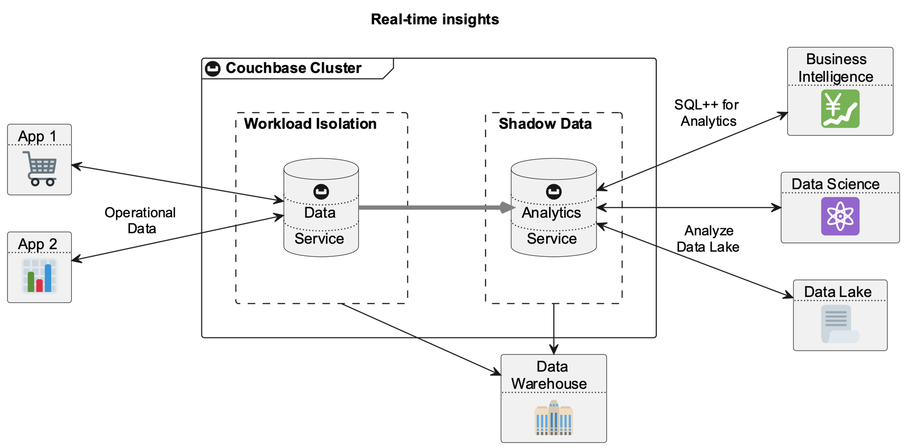
Analytics
Analytics service allow the user to combine data from CouchBase and other data sources (like Amazon S3, Azure or Google Cloud platform), data can be processed in real time on a shadow copy consistent with the real copy.

Slide 28
Eventing
Eventing is a powerful tool in CouchBase, it can be useful in data integrity check, or to analyze data when they are ingested. Functions can be mapped to a collection, every upload, edit or delete of file will trigger a callback function written in JavaScript.

Slide 29
References
Docs:
https://docs.couchbase.com/home/index.html
https://docs.docker.com/
Images:
https://www.flaticon.com
https://docs.couchbase.com/home/index.htm
Slides:
https://github.com/pietro-nardelli/sapienza-ppt-template
Presentation Title - Name Surname

Slide 30
Thank you for the attention!

